Slide 1

High-Level Overview of Entire EmbeddedMontiArc Project
EmbeddedMontiArcStudio
Sprachen
Generatoren
Simulatoren
Michael von Wenckstern,
Evgeny Kusmenko
Software Engineering
RWTH Aachen
http://www.se-rwth.de/
Notes:
Nicht löschen: Vorlage V32

Slide 2
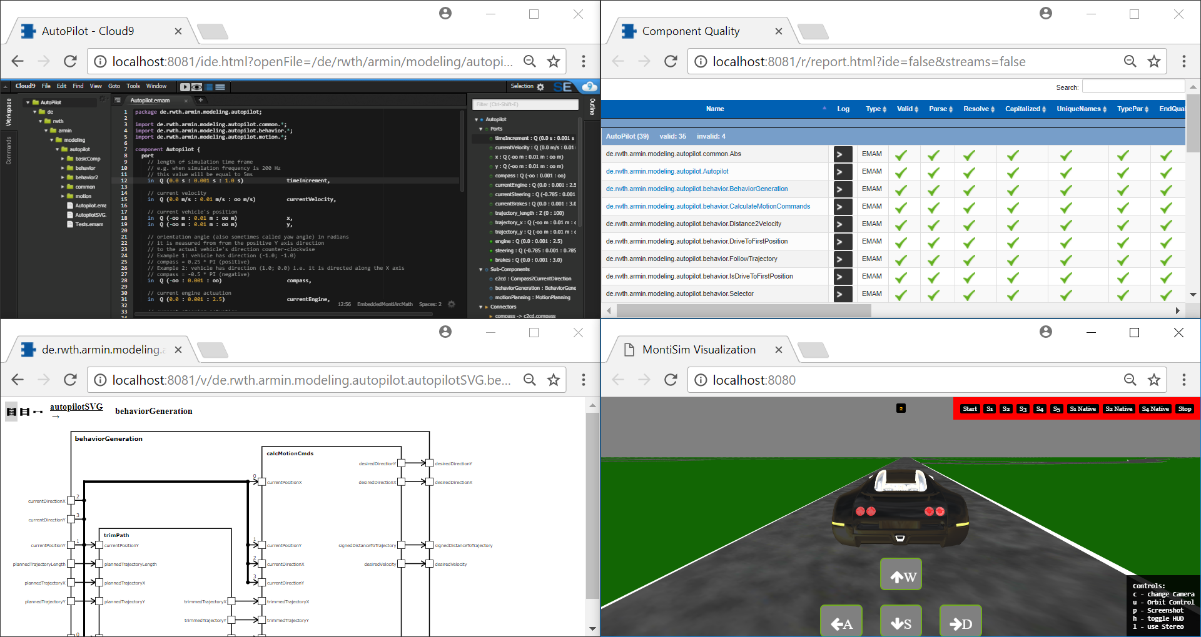
EmbeddedMontiArc for SLE (teaching)
Developing Large Language Families with MontiCore is easy
Our Language Family contains about 25 MontiCore grammars
Developing powerful Modeling Tools with MontiCore is possible
EmbeddedMontiArcStudio is based on MontiCore infrastructure
Multiple Teams can develop language tools together
EmbeddedMontiArc is developed by ca. 15 students in parallel
Developing with MontiCore is Fun ;) (Can execute the models and see the car drifting)

Slide 3
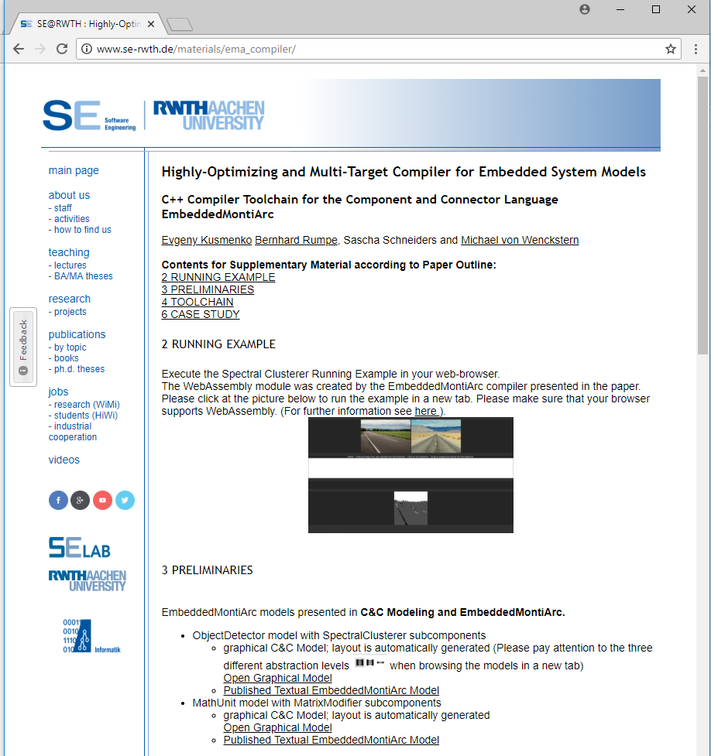
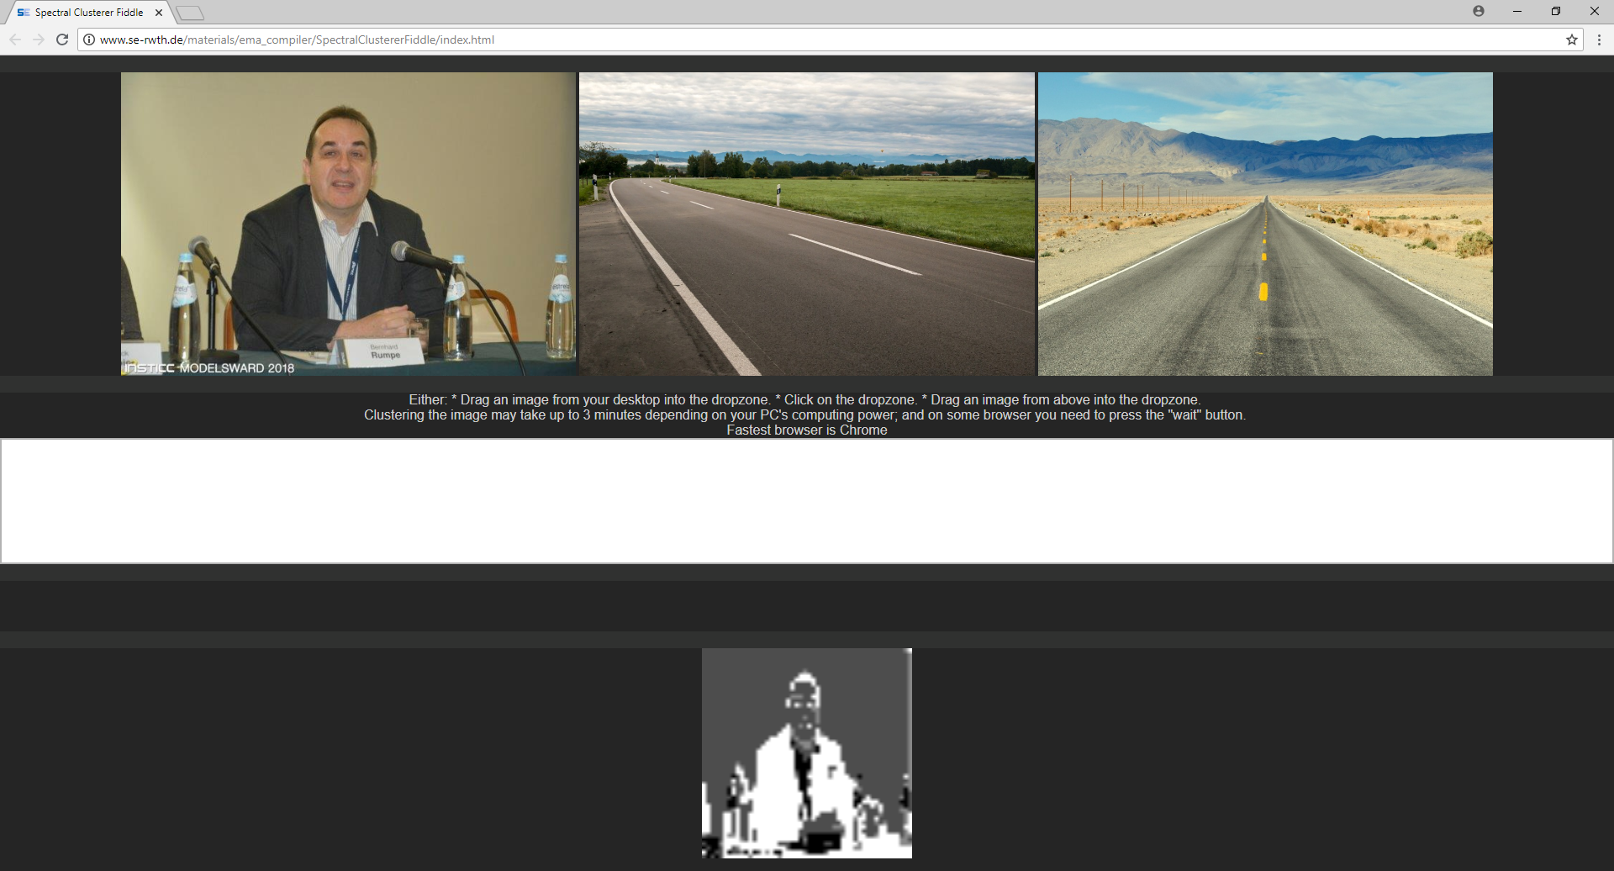
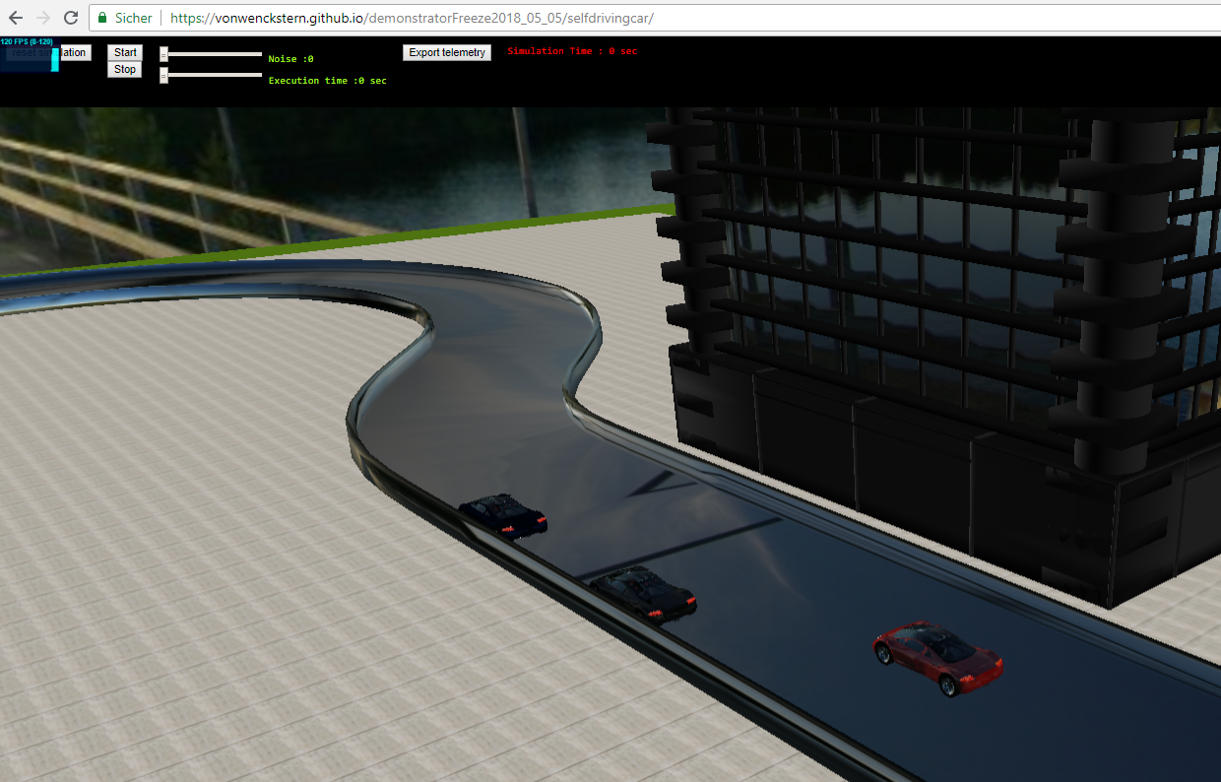
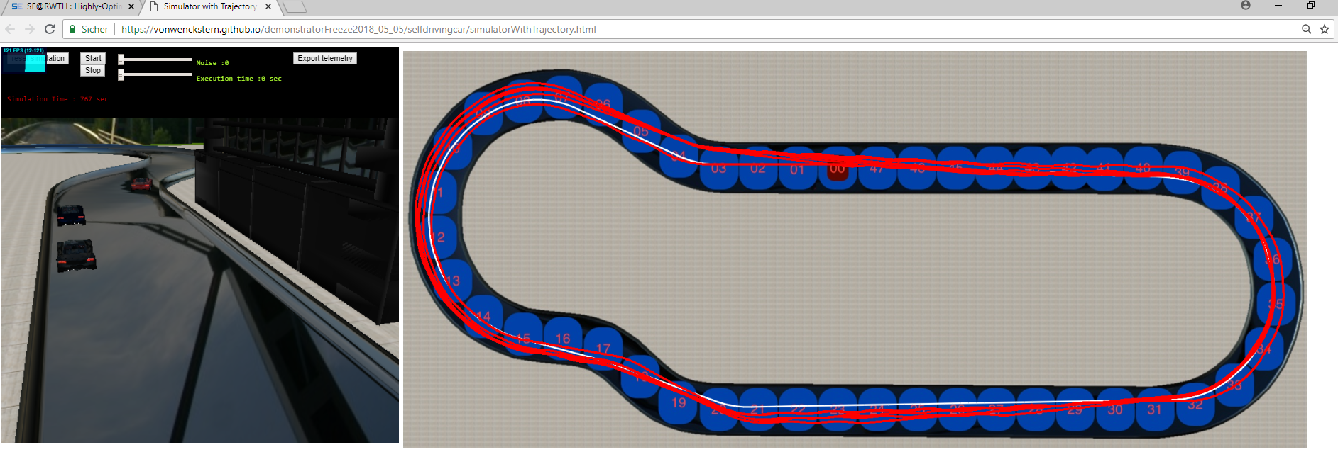
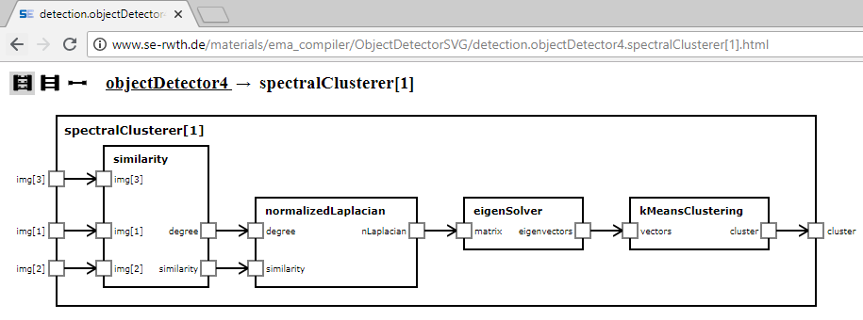
EmbeddedMontiArc for Publications
Reviewers can
Inspect Models (textual and visual representation) in Browser
Execute generated Code in Browser
Gain confidence about tools or make larger models online available
Execute Models in Browser
Can be directly uploaded to SE homepage
Inspect Models in Browser
http://www.se-rwth.de/materials/ema_compiler/

Slide 4
Agile Development with EmbeddedMontiArc
Version Control Support
Multiple Users can work parallel
Design Under- specification
Non-Functional Requirements
Textual Modeling
in the Large
pull / push
Reports
Coverage
Generation of Witnesses
mvn
Structural & NFR Requirements
Git
Nexus
WWW
Design & NFP Verification
measured values
clone
mvn
«use»
update params
CI/CD Features
Add non-functional
«use»
Data Analytics
Evolutional Genetic Algorithms
Model based Testing
Model based Optimization
Textual Stream Unit Tests
Model based Simulation
Integration Tests including Environment

Slide 5


EmbeddedMontiArc as DataSource
EmbeddedMontArc language family MontiCore grammars with language aggregation, and language embedding
Have over 1‘500 models for EmbeddedMontiArc grammars → large model repository
Over 10 (RoutePlaning, Parking, ADAS, PacMan, SuperMario, Wheather Balloon, Image Clustering, LapRacing, PumpStation, Turbine Controller) complete presentable examples
EmbeddedMontiArc incl. Simulator over 70 gitlab repos
Tested new features in MontiCore 5 (detected some bugs)
Artifacts are analyzed with SH’s tool (detected some bugs)
Repos can be used to teach DevOps (Git, CI, CD & more)
Java
EMAM
MC5

Slide 6
EmbeddedMontiArc Integrates SE Methods
EmbeddedMontiArcStudio (available for Windows 64bit and Linux*) integrates many SE methods
Stream Testing (based on AH’s methods)
View Verification (based on JOR’s methods)
Tagging (based on ML methods)
Language Aggregation via Symbol Table (based on PN methods)
OCL/P and CD4A** (using languages and concepts; BR UML/P)
Generator Composition (using MC’s template concepts)
Simulation and Co-Simulation (inspired by CB)
Deployment and Library Concept** (uses AH’s SE Infrastructure)
Reporting Features (inspired by MontiCore)
* Virtual Machine will be uploaded in next two days
** Full Integration will be finished in 2 months

Slide 7
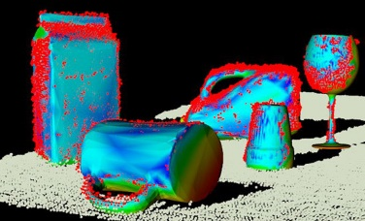

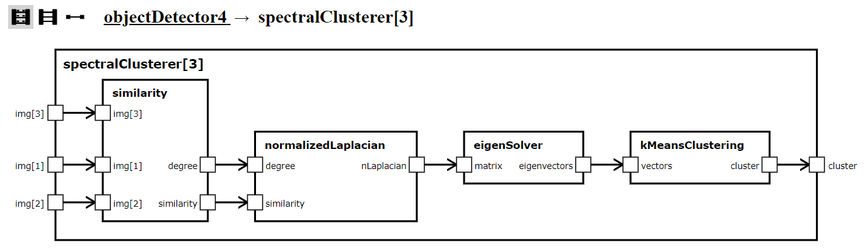
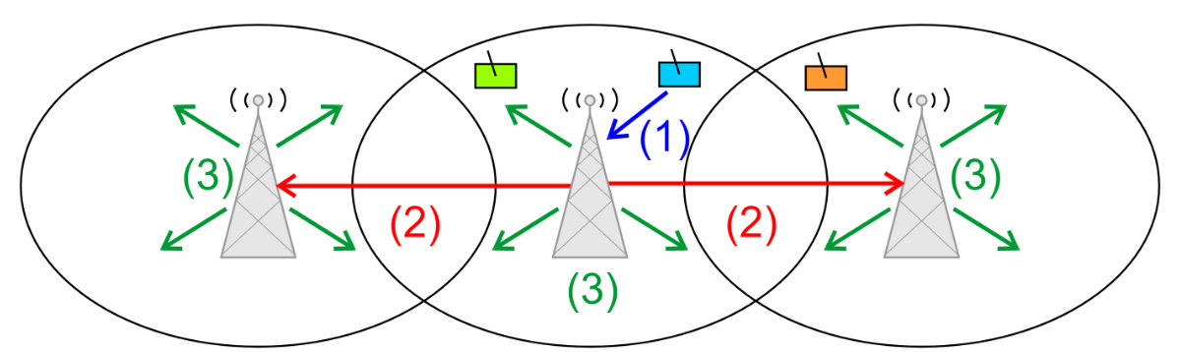
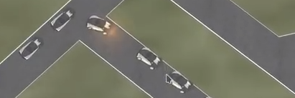

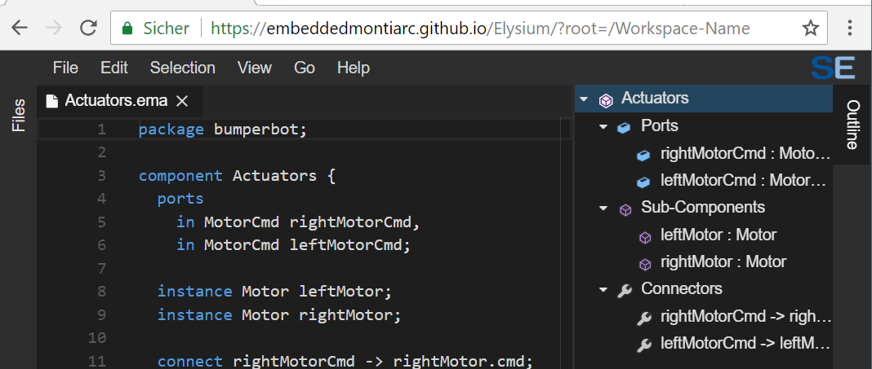
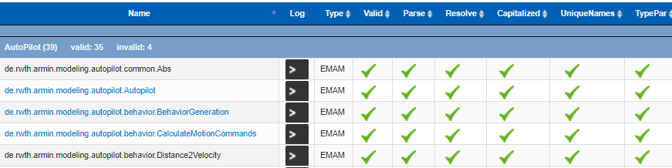


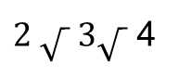
EmbeddedMontiArc Main Features
Car
$2 \sqrt{ } 3\sqrt{ }$ 4
ADAS
Unit Testing
Views & Verification
AI & Image Recognition
Modeling
Automatically Layouting
Simulation
Acceptance Testing
Reporting
IDE

Slide 8
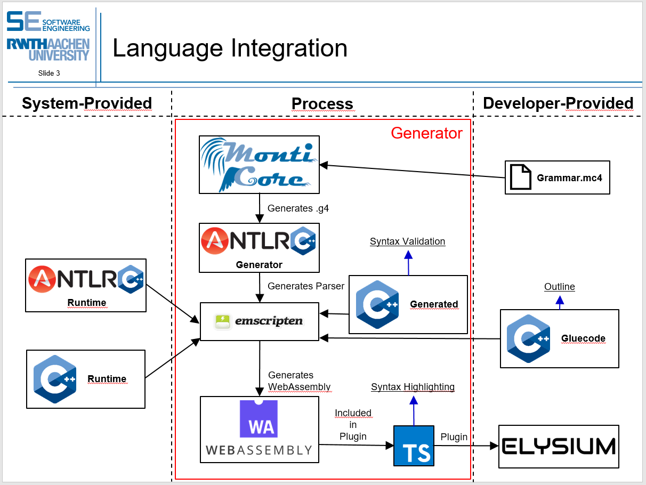
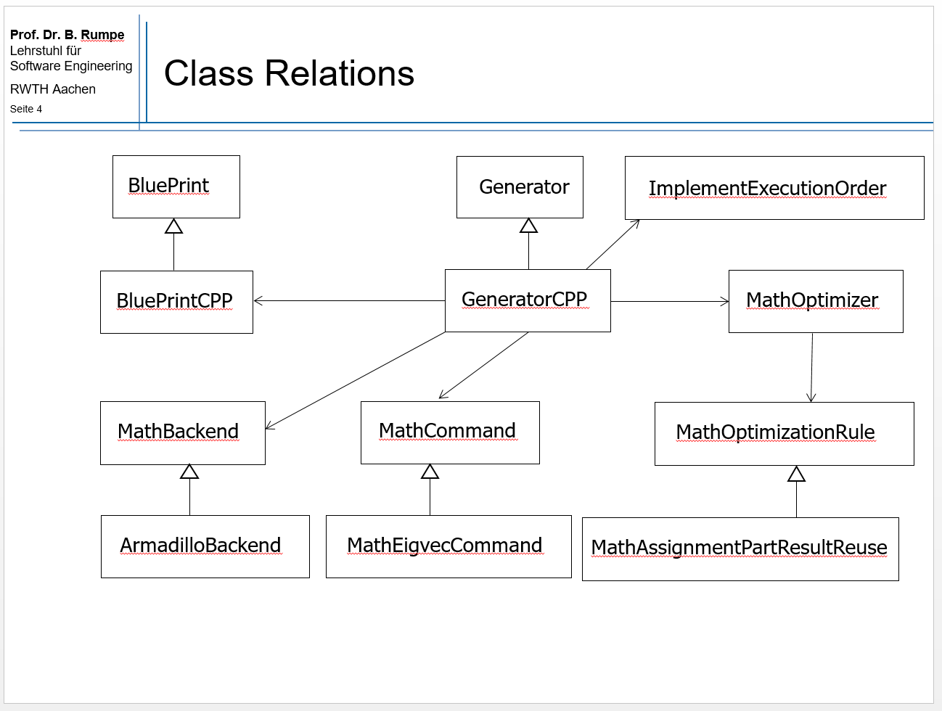
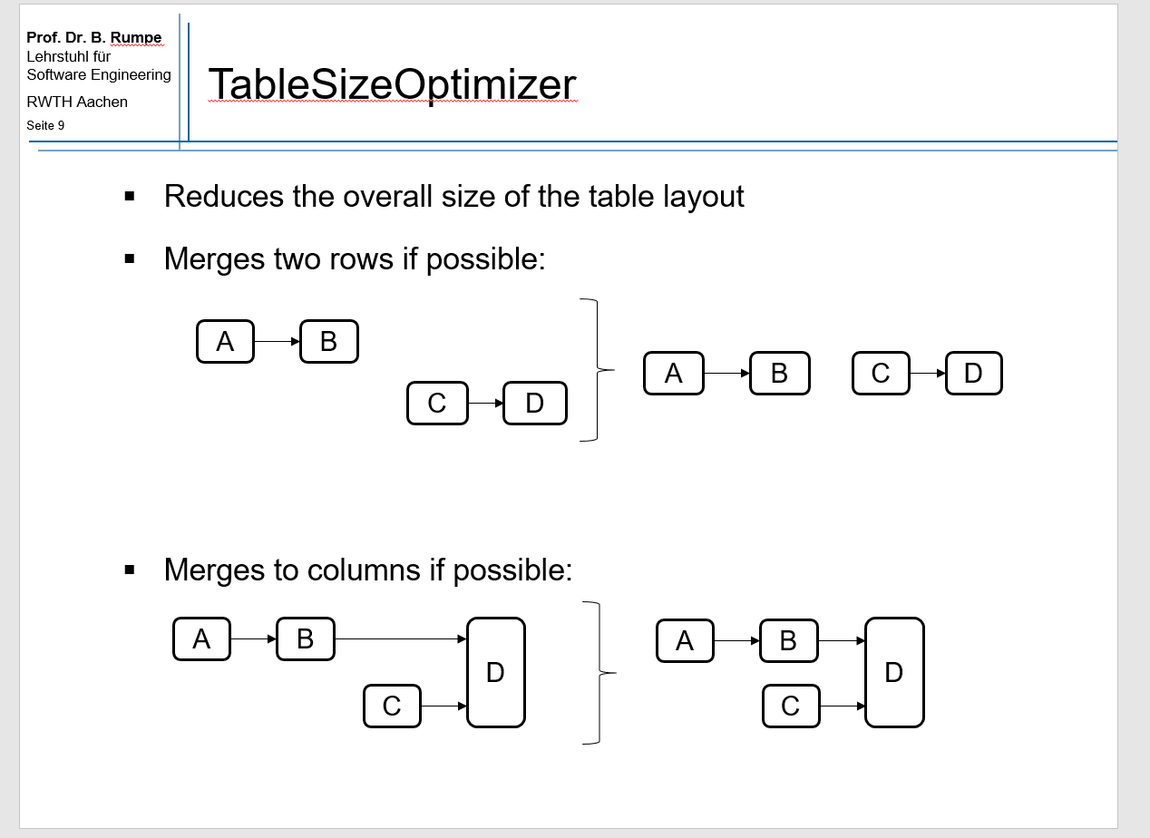
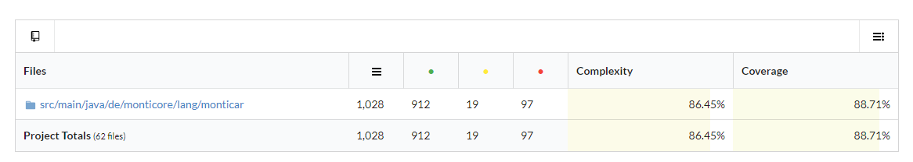
EmbeddedMontiArc Repo Quality
Research Prototype: Can be shown at conferences
Own Documentation Repository: https://git.rwth-aachen.de/monticore/EmbeddedMontiArc/Documentation
Main Repositories are documented by itself: 14 Compact PPTX-Presentation about Design & Algorithms https://git.rwth-aachen.de/monticore/EmbeddedMontiArc/Documentation/tree/master/reposlides
Many Unit- and Integration Tests (Test Coverage about 75%)
Activated Test Pipeline in GitLab
Architecture
Class Relation
Algorithm

Slide 9
Basic Architecture Design Decisions
All steps are Self-Contained Services (communicate via CLI or via REST)
Each SCS can use a different MontiCore version
Can be developed and replaced independently
Batch files chain SCS together to useful activities
E.g. C++ Generator → CLANG → Simulator/3d Visualisation
Bundled as portable application in an archive EXE (only Windows 64-bit as requirement)
C++ Generator/ Testing
SVG Generator
Online-IDE
Reporting & Metrics
Simulators / 3d Visualisation
Notes:
Blue: Parser
Pink: SymbolTable Creator
Orange: CFG-Anaysis and Optimizer
Lila: Freemarker (C++ Output)
Rot: Layout-Berechnung
Helles Lila: Freemarker (SVG Output)
Braun: Virtual File System API
Dunkelgrün: Cloud9 API
gelb: Github-API
grau: Context Conditions/Metrics
dunkelblau: Open Street Map Importer
türkis: Physic Engine
--: ThreeJS 3D Visualisation

